Slide 1
MS Project Overview Tasks Entry and Relationships
Module 03
Knowledge, which is acquired under compulsion, obtains no hold on the mind.’ -Plato‘

Slide 2
Agenda
Schedule Development Stages
MS Project SW Overview
Project Information
Generic Project Structure
Project Tasks (Activities/Summary)
Project Tasks Milestones
Recurring Tasks
Task Notes
Relationships

Slide 3
Schedule development Stages
Task Entry (Module 1)
Project Level Task
Task Logic (Module 1 & 2)
What order are the activities (tasks)?
Task Constraints (Module 2)
Resource Creation and Allocation (Module 3)
Schedule Balancing (Module 5 & 6)
Triple Constraint Management
Sub-Deliverables
Work Packages/Products
Activities
Milestones
Support Activities (Meetings)
Task Relationships:
- What task is next?
- What task are we waiting for?
Is there a delay before next task
What must happen on a particular date?
What must happen before/after a date
When should I finish this task
What People (work) resources
What machines (work)
What materials (materials)
What extra costs (costs)
Overallocation of resources removed
Schedule dates met
Cost Constraints met
Variances
Analyze
Adjust
Reporting/Exporting/Importing

Slide 4
MS Project Overview
Understand the major components of MS Project
Open MS Project
Create a new project
Navigate MS Project Default Screens

Slide 5
MS Project
Incorporates functionality of common software applications:
Database: manages data about tasks, durations, resources, costs, constraints
Spreadsheet: task lists, time and cost calculations
Chart/Diagrams: graphical views of project information (Gantt Chart, network diagrams and Calendars)
Report Generation: pre-defined reports

Slide 6
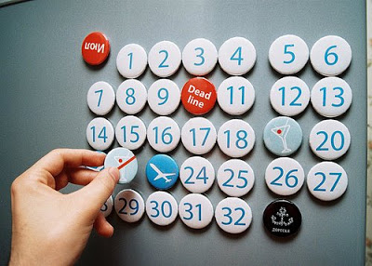




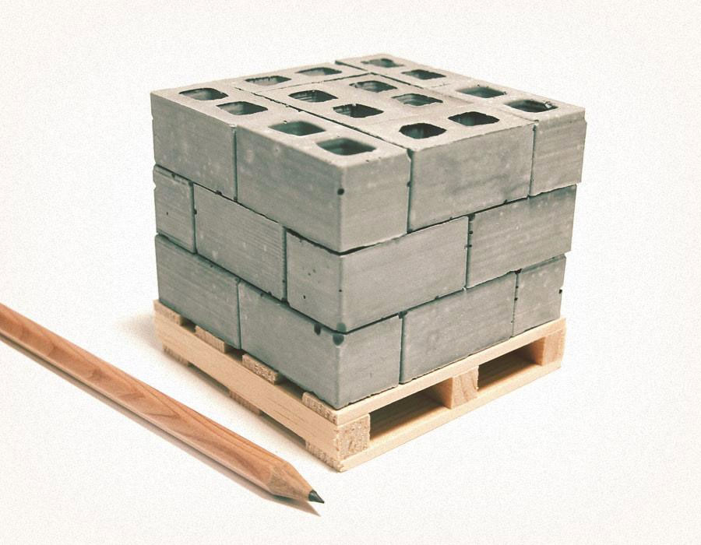

Database
There are 4 basics object groups:
Tasks
Resources
Calendar(s)
Assignments
Notes:
These Photos by Unknown Author is licensed under CC BY

Slide 7
MS Project Screen Sections
Gantt chart: tasks as horizontal bars, milestones, task dependencies, split bar drags
Table(s): scrolling, adding new columns
View bar along left side of window
Network diagram: critical path, tasks as boxes (nodes), dependencies linked with lines
Calendar View: Summary view of tasks view as a calendar
Timeline

Slide 8
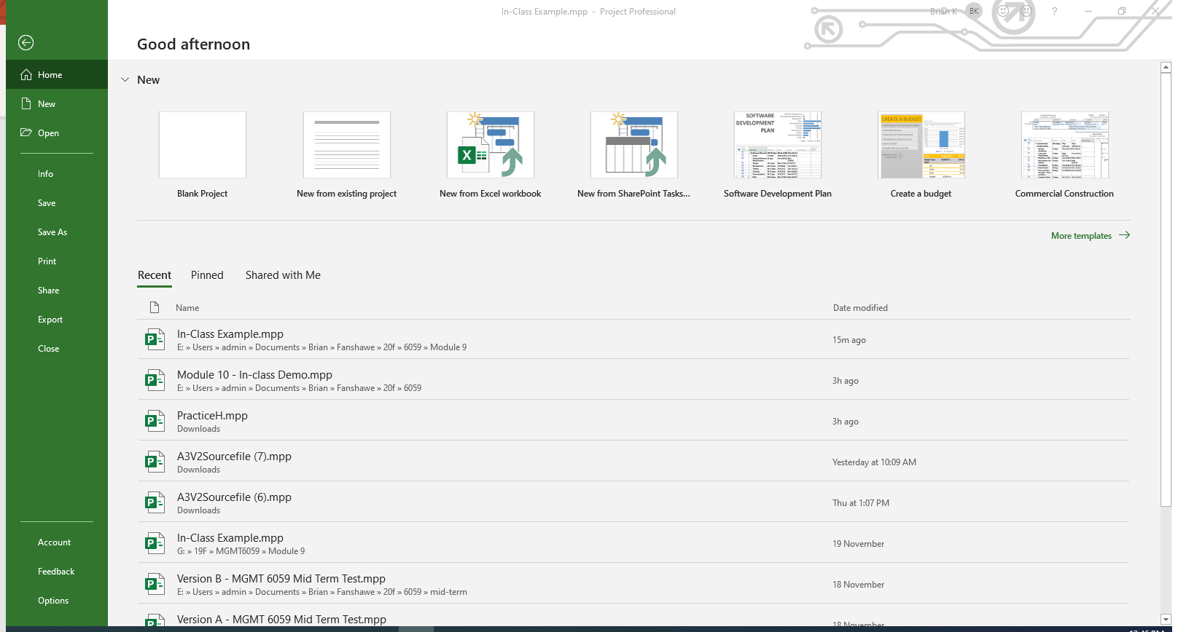
Open MS Project
Blank Project
Templates
Recent Files
Options
Notes:
Build slide works best in slide show mode

Slide 9
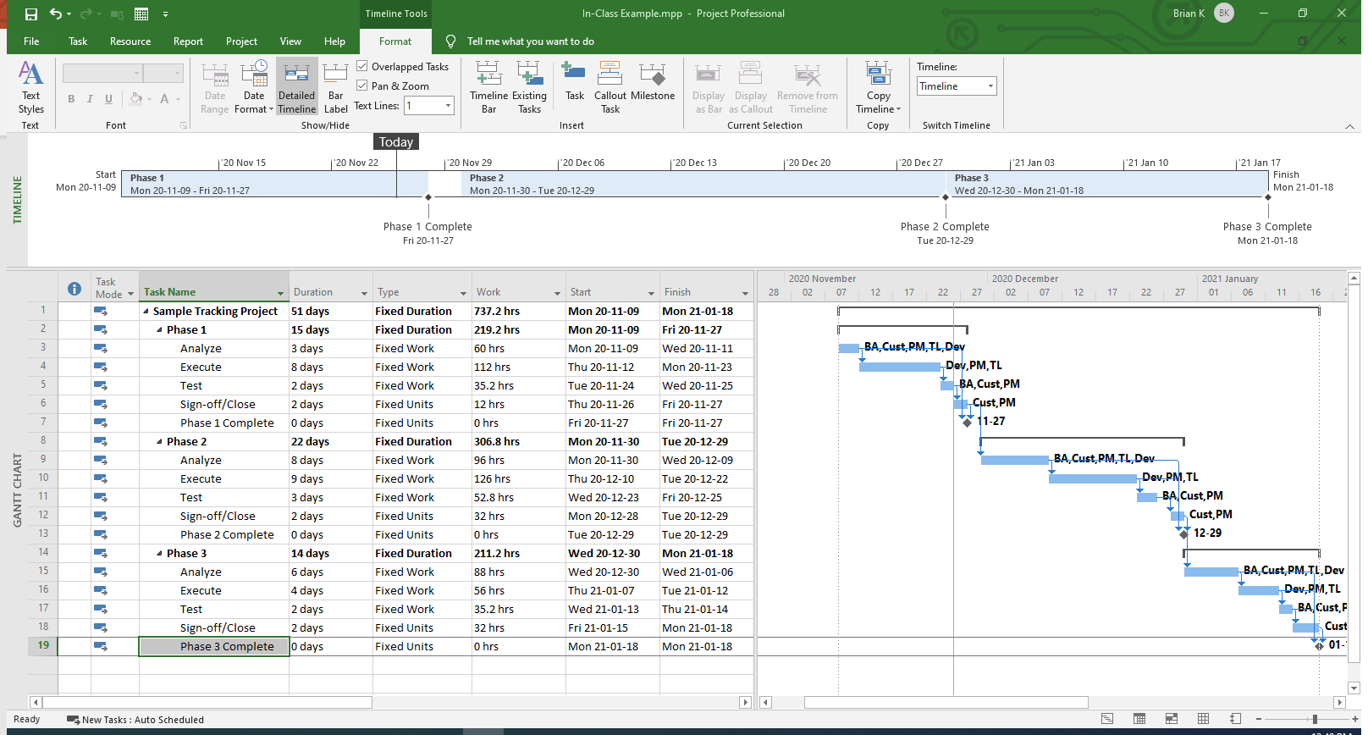
Gantt Chart View (Default)
Toolbar
Ribbon
Timeline
View Bar
Gantt Chart
Table
Zoom Control
Notes:
Build slide works best in slide show mode

Slide 10
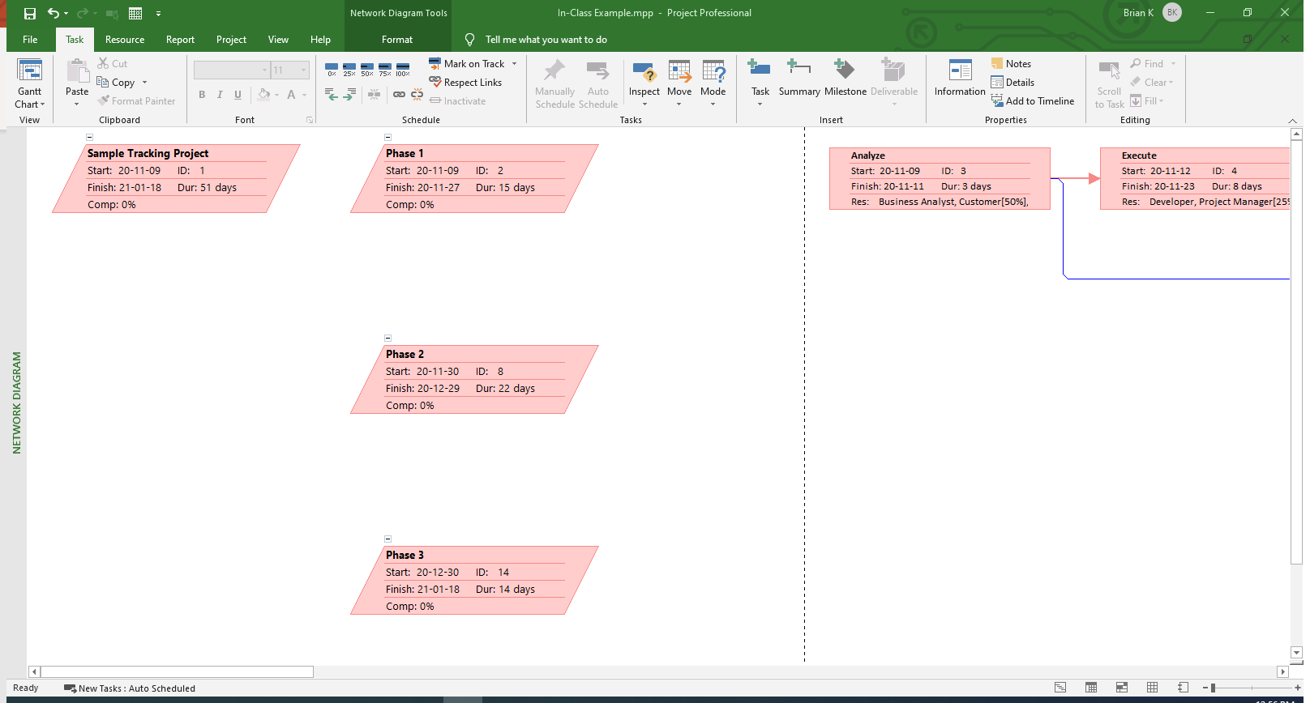
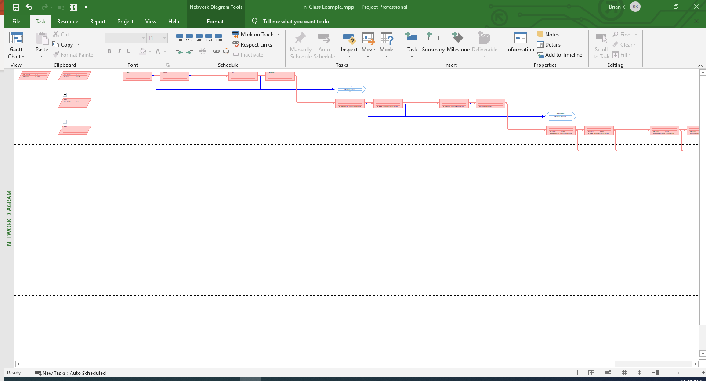
Network Diagram View
Zoomed in for Detail
Zoom Control
Zoomed out for Overview
Notes:
Build slide works best in slide show mode

Slide 11
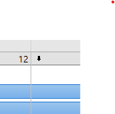
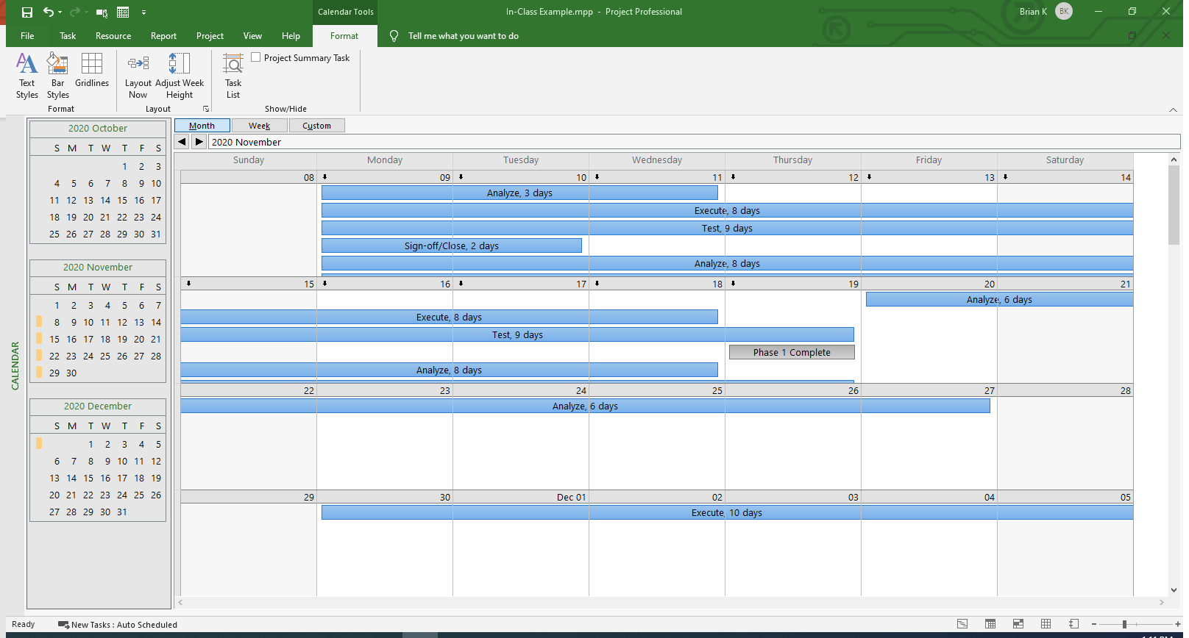
Calendar View
Months
More Detail Available
More Detail Available
Detail Level
Notes:
Build slide works best in slide show mode

Slide 12
MS Project Overview Example
Open a new project
Describe each section of the default screen
Demonstrate Zoom on Gantt
Show each toolbar option
Emphasize each one (ie. Task, Project, View)
Show Network diagram
Demonstrate Zoom
Demonstrate manual move
Show Calendar
Month/Week/Year
Additional Tasks hidden

Slide 13
Project Creation
Create a project
Set-up Schedule Type and Date

Slide 14
Open MS Project
Blank Project

Slide 15
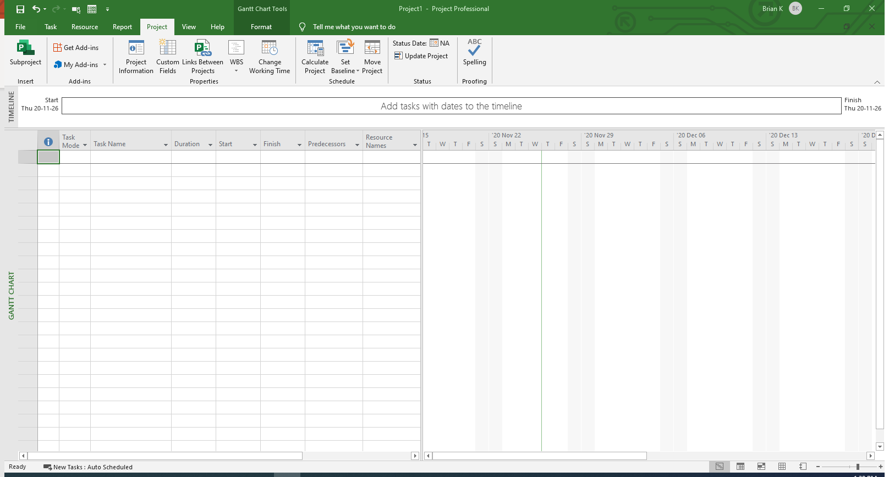
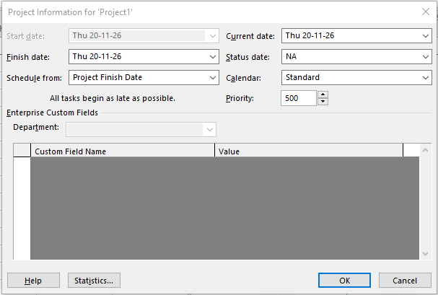
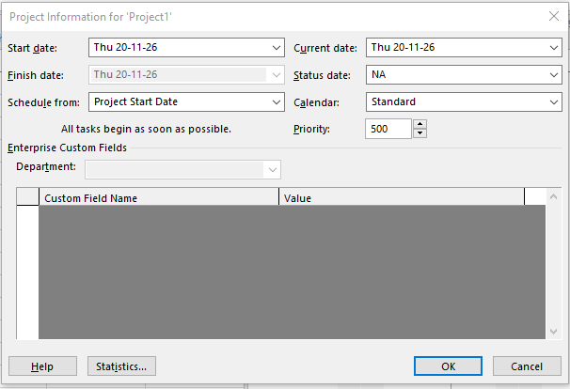
Project Attributes
Select Project Tab
Finish Date
Project Information
Start Date
Schedule from Start
Default Constraint
Schedule from Finish
Default Constraint
Notes:
Build slide works best in slide show mode

Slide 16
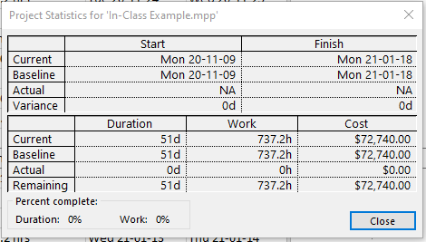
Project Attributes
Current Date
Status Date
Project Calendar
Project Statistics
Notes:
Build slide works best in slide show mode

Slide 17
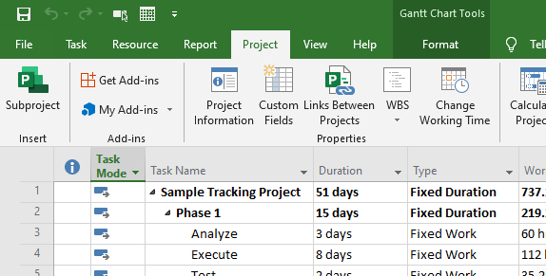
Save/Save as
Save Project
Save
File
Save As
Notes:
Build slide works best in slide show mode

Slide 18
Project Creation Example
Open New Project
Change tasks to Auto Schedule
Open “Open Project Information Box”
Schedule from:
Project Start
Project Start Date
Set Start Date to today
Project Finish
Project Finish Date
Set Finish Date to a month in advance
Show Project Calendar
Show Project Statistics
Save Project
Icon
Save
Save-as

Slide 19
Generic Project Structure
Understand the Program specific project structure
Replicate that structure in a Project

Slide 20
Example WBS with Activities
1.0 Project Deliverable
Error - Activities Attached to Subdeliverable
1.1 Sub-deliverable
1.2 Sub-deliverable
1.3 WP
1.2.1 Activity
1.2.2 Activity
1.3.1 Activity
1.3.2 Activity
1.3.3 Activity
1.1.1 WP
1.1.2 WP
1.2.1 WP
1.2.2 WP
1.1.1.1 Activity
1.1.1.2 Activity
1.1.2.1 Activity
1.1.2.2 Activity
1.1.2.3Activity
1.2.1.1 Activity
1.2.1.2 Activity
1.2.1.3 Activity
1.2.1.4 Activity
1.2.2.1 Activity
Note: the layout of this WBS has been skewed graphically in order to make the next slide clearer.
Activities can only be attached to WP’s. An additional WP would have to be created below 1.2, and have the two Activities attached to the Sub-deliverable 1.2.

Slide 21
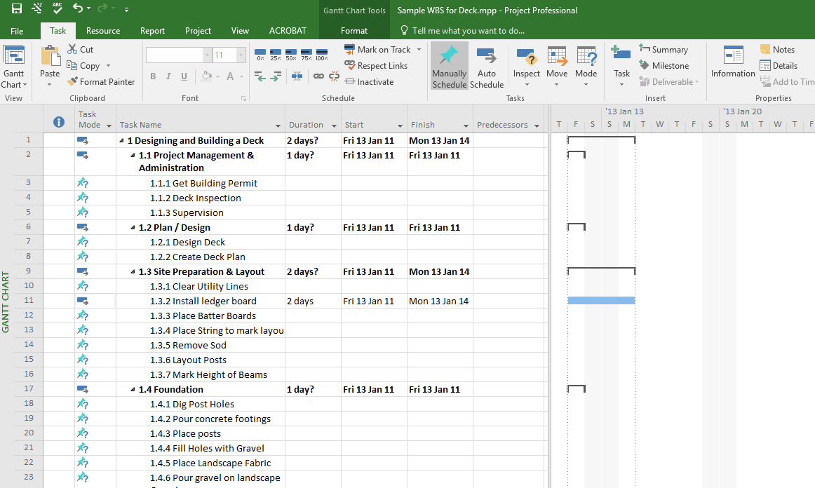
An Example of a WBS with Activities in MS Project
This particular project only has 2 levels of Deliverables plus an Activity level for a total of just 3 levels including Activities.
Summary Tasks in MSP have this symbol and are automatically bolded by MSP. They represent a “Deliverable” at various levels in the WBS.
Detailed Tasks in MSP will show this Gantt chart symbol only if they are given a duration. They represent an Activity. We enter details manually, such as durations in these Detailed Tasks. Durations for Summary Tasks are calculated automatically by MSP (hence the name “summary”) based on the Detailed Task (Activity) durations.
We control the levels of the WBS by using the indent and outdent buttons.
Typically there are multiple Activities in a WP
Activities are only found below (indented) a Work Package (WP). A WP is a special Deliverable, it is the lowest level Deliverable in any branch of the WBS.

Slide 22
Project Tasks
Create tasks
Reorganize tasks
Indent/Outdent Tasks – Create Summary tasks
Enter Basic Task Information

Slide 23
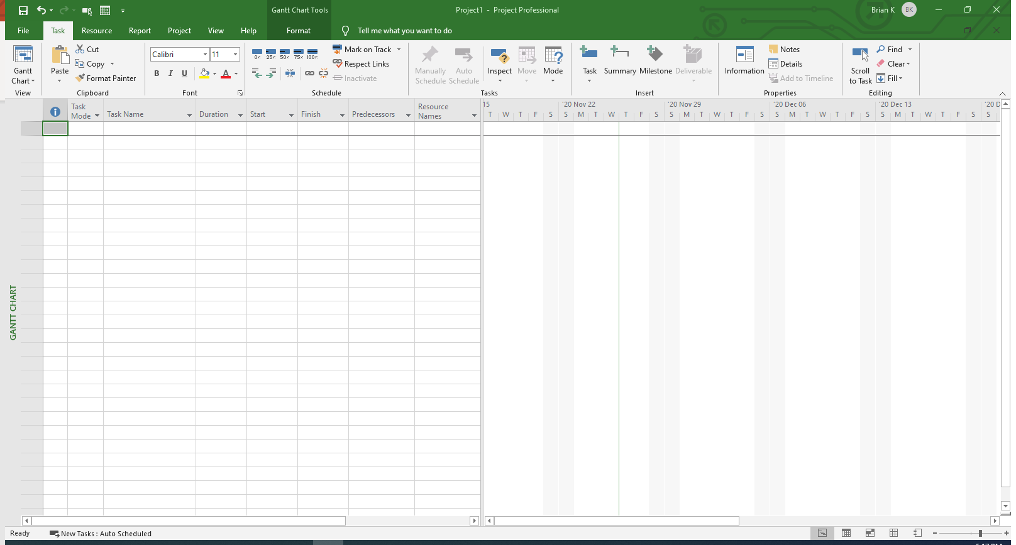
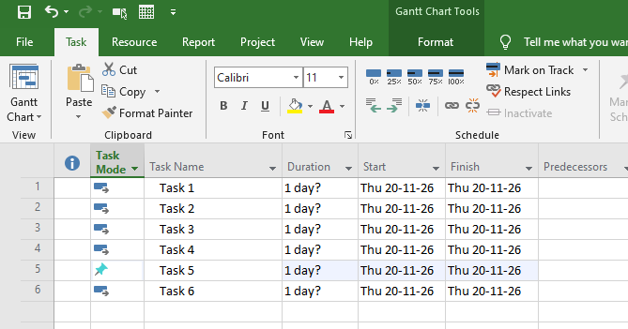
Adding a Task
Task Name
Default Duration
? Means Estimated
Task Name
Insert Task
Project Start Date
Task Schedule Type
Manually Scheduled
Auto Scheduled
Notes:
Build slide works best in slide show mode

Slide 24
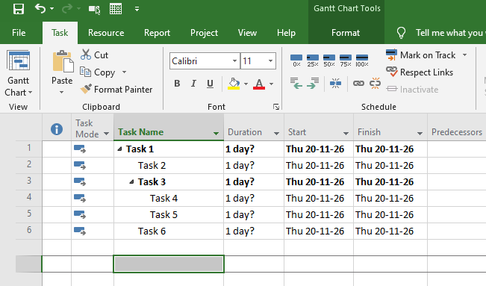
Indent tasks to create Summary tasks
Indent/ Outdent
Use Mouse
Notes:
Build slide works best in slide show mode

Slide 25
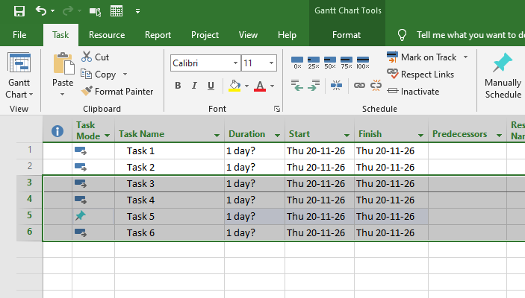
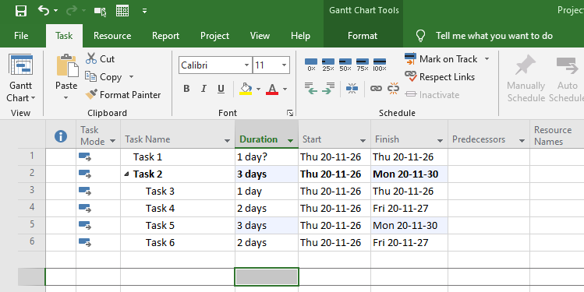
Indent Multiple tasks to create Summary tasks
Indent/ Outdent
Use Mouse
Dates Updated
Duration Updated
Fields That Changed
Notes:
Build slide works best in slide show mode

Slide 26
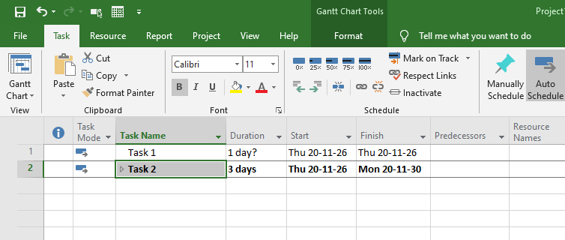
Indent Multiple tasks to create Summary tasks
Summary Task
Click to Collapse/ Hide
Click to Collapse/ Hide
Notes:
Build slide works best in slide show mode

Slide 27
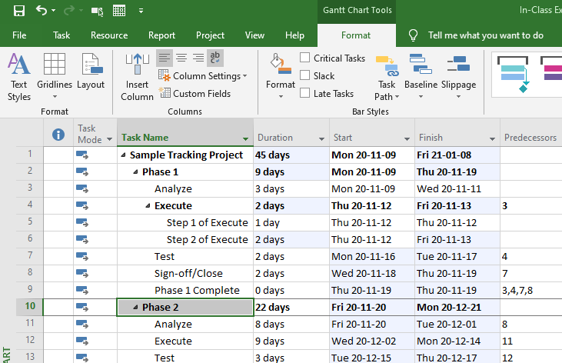
Multiple Levels of Indent
Summary Task
Summary Task
Multiple Levels
Multiple Levels
Multiple Levels
Multiple Levels
Activity
Task
Activity
Task
Activity
Task

Slide 28
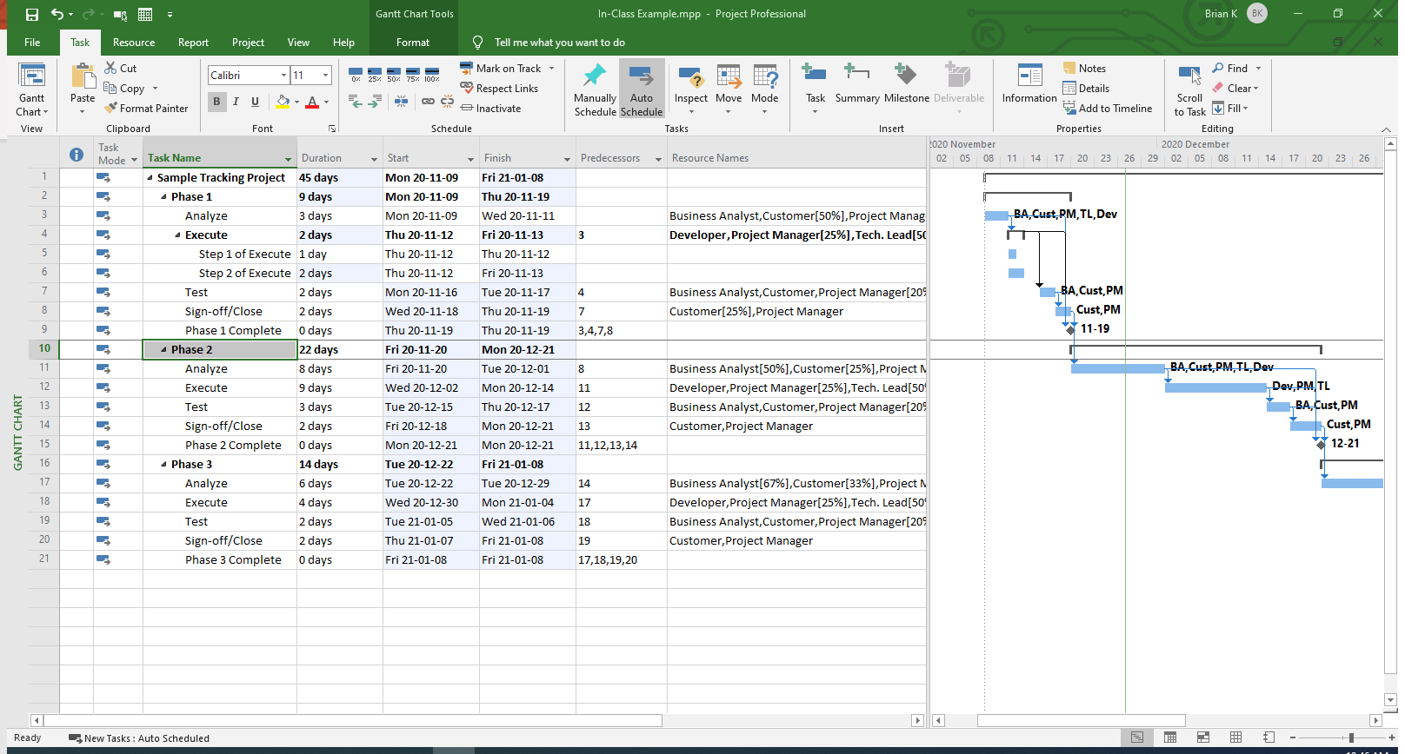
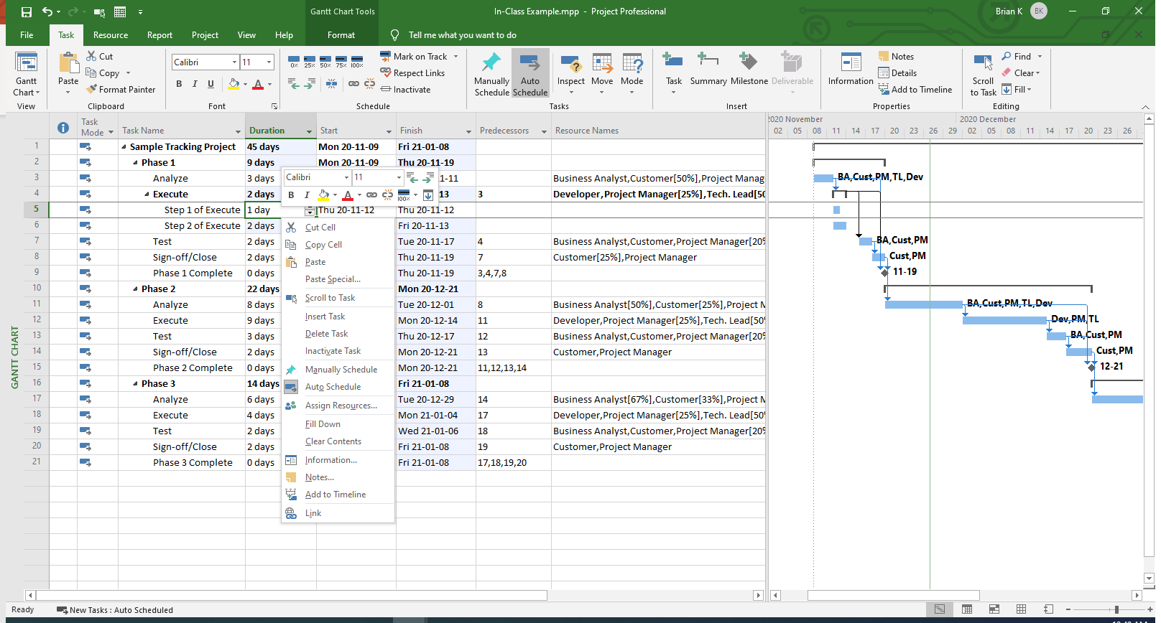
Task Information
Task Info. Button
Double Click Task
Right Click on Task
Select– Information

Slide 29
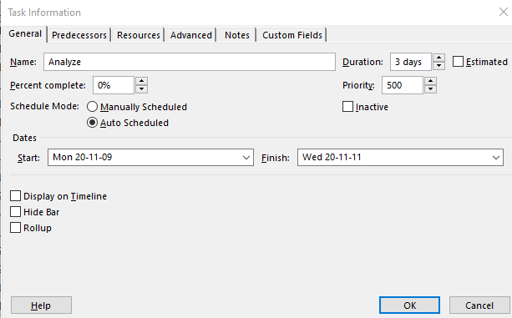
Task Information
Task Name
General Tab
Estimated (?)
Duration
Start Date
Finish Date

Slide 30
Task Example
Task Entry:
Directly on Entry Table
Describe task info. Dialog box General Tab Fields
In Task Form
By + Task button
Insert a task (between existing)
Relocate Tasks (Drag and drop)
Indent/Outdent:
By indent/outdent utton
By arrow
Multiple task indent

Slide 31
Project Milestones
Understand Milestone best practices
Create a Milestone

Slide 32
Milestones
“A milestone anticipates what the project is supposed to achieve at a pre-set date. It should describe a desired state of affairs, a desired future situation. There are two important aspects to this. First, the concept refers to a point in time, not a period of time. Second, it looks forward to what we want to create, not how we create it.”1
General Rules for this class about milestones:
No duration (they should be 0 duration tasks)
No resources assigned (see above, “not how we create it”)
¹ Andersen, E. S. (2006). Milestone planning—a different planning approach. Paper presented at PMI® Global Congress 2006—Asia Pacific, Bangkok, Thailand. Newtown Square, PA: Project Management Institute.
Notes:
Quote found on PMI website, reference from article.

Slide 33
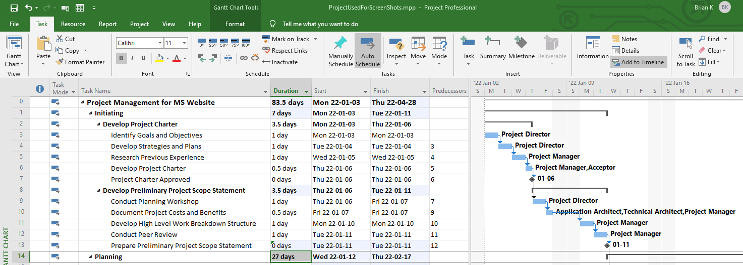
Milestones
Duration = 0
Duration = 0
Milestone Symbol
Milestone Symbol
Source: Bunin, New Perspectives on Microsoft Project 2010

Slide 34
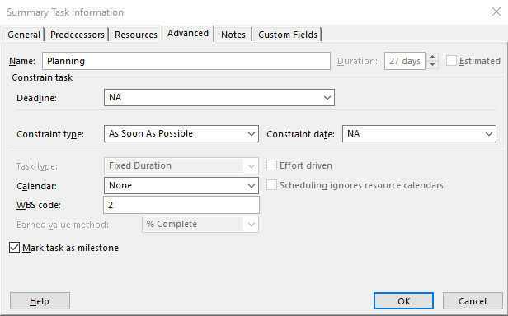
Milestones
Double Click on Task
Milestone Symbol
Source: Bunin, New Perspectives on Microsoft Project 2010

Slide 35
Milestone Task Example
Directly on Entry Table
Enter 0 Duration
Show the symbol changes
Task Information Dialog:
Shift to “Advanced” tab
Click on milestone box
Show the symbol changes
Warning when changing by using advanced-milestone you may have duration on milestone but symbol remains the same

Slide 36
Recurring Tasks
Understand Recurring Task best practices
Create a Recurring Task
Modify a Recurring Task

Slide 37
Recurring Tasks
Common Usage:
Meetings
Checkpoints
Repetitive tasks (ex: time entry)
Can be changed (frequency, duration, recurrence, etc.)
They have a constraint assigned and therefore may not move as expected if there is a significant change in project dates.
Symbol ( )in “Indicator column”

Slide 38
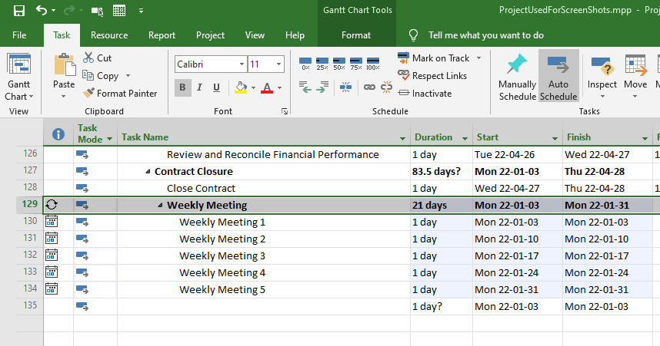
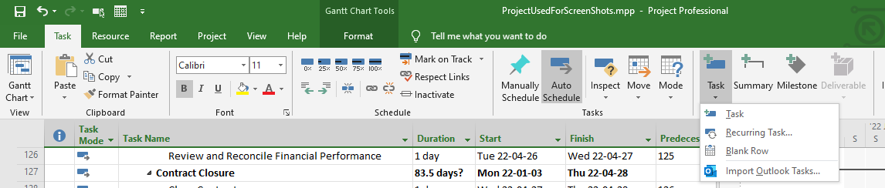
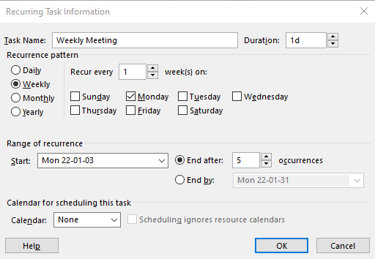
Recurring Tasks
Task Tab
+Task Tab – Recurring Task
Frequency
Start – Default Project Start Date
Recurrence
Occurances

Slide 39
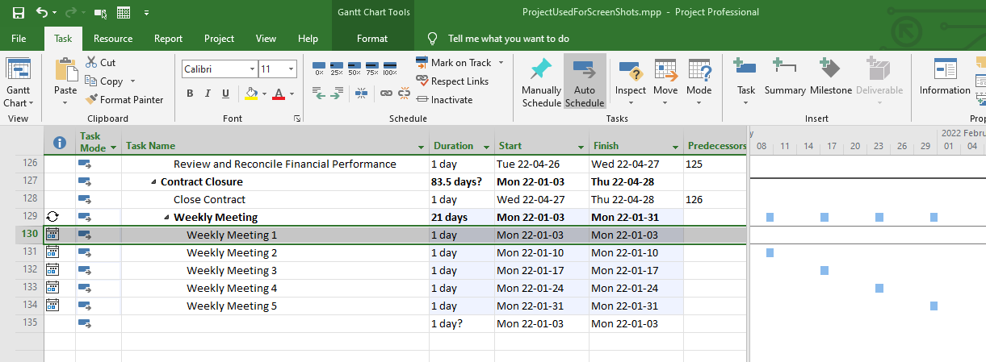
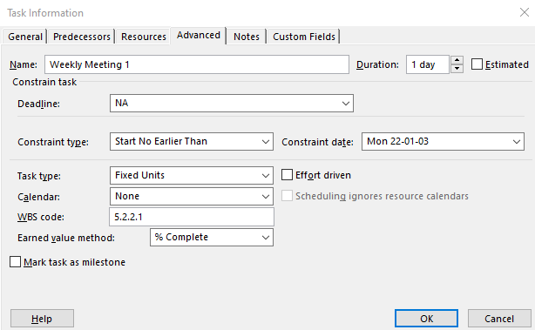
Recurring Tasks
Recurrence Symbol
Constraint
Constraint
Gantt Chart View
Gantt Chart View

Slide 40
Recurring Task Example
Add recurring meeting
View in Gantt and Entry Table
Hover over recurrence to see information
Click recurrence symbol to edit
View results of edit
Click Constraint and view “Advanced” tab for constraint

Slide 41
Task Notes
Understand notes best practices
Create a task note
Quick view a task note

Slide 42
Notes
Common Uses:
Tasks that require action (if you need to change something about a task)
Important source information that may influence future actions
Subcontractor Information if it is not “Your” task
Conditions that you may want to clarify
Key Considerations:
Use sparingly – don’t clutter project. It should be important
Use as for actions that need attention
Visual reminder of action required
Don’t use for documentation

Slide 43
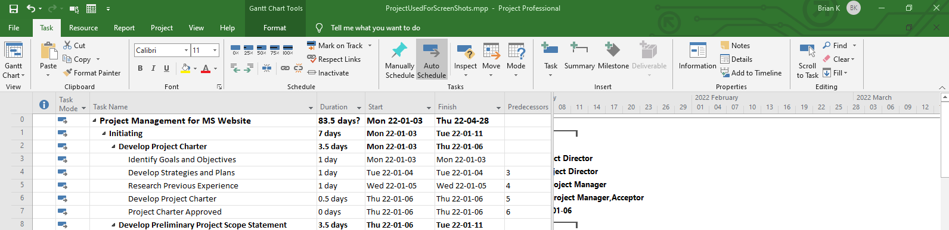
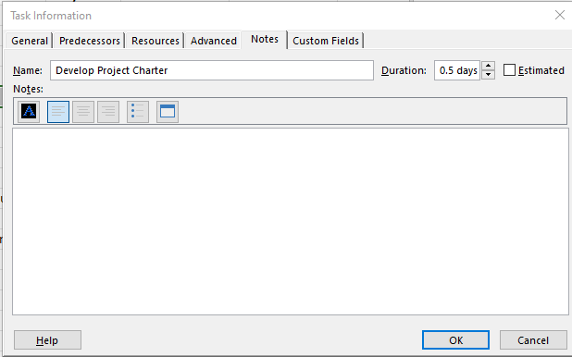
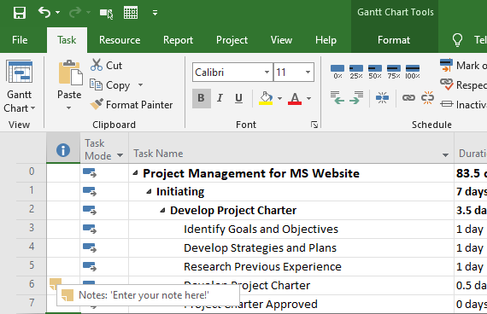
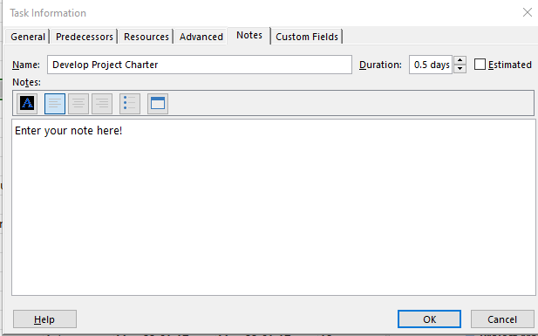
Notes
Click Notes
Task Info. Box – Notes tab
Double click and Pick Notes Tab
Right click and select Notes
Enter Note
Hover cursor to see note

Slide 44
Notes on a Task
Show 3 ways of getting to notes
Enter a note and show icon
Hover over note icon to see contents

Slide 45
Task Relationships
Understand the 4 types of relationships
Link tasks using all 4 relationship types
Review relationships on Gantt Chart
Review relationships on a Network Diagram

Slide 46
Relationships
Used to create “logic” between the tasks
Facilitates changes when dates change
Models questions:
What happens after this task
What must happen before this task
Creates the structure of the Project Schedule
This phase is CRITICAL to creating a manageable, maintainable and informative schedule. A bad job here and you will suffer throughout ALL the remaining phases of schedule development and schedule execution.

Slide 47
Dependencies Descriptions
Code | Dependency Type | Meaning
FS | Finish-to-Start | Predecessor’s finish determines successor’s start
SS | Start-to-Start | Predecessor’s start determines successor’s start
FF | Finish-to-Finish | Predecessor’s finish determines successor’s finish
SF | Start-to-Finish | Predecessor’s start determines successor's finish
By default, when you link tasks, they are defined as a Finish-to-Start relationship

Slide 48
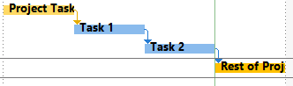
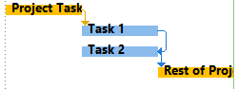
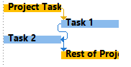
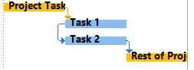
Creating Relationships
Finish to Start (FS) - default
Finish to Finish (FF) (FF)
Finish
Finish
Start
Finish
When Task 1 finishes Project will schedule task 2 to start
When Task 1 finishes Project will schedule task 2 to finish
Start to Finish (SF)
Start to Start (SS)
Start
Finish
Start
Start
When Task 1 starts Project will schedule task 2 to finish
When Task 1 starts Project will schedule task 2 to start

Slide 49
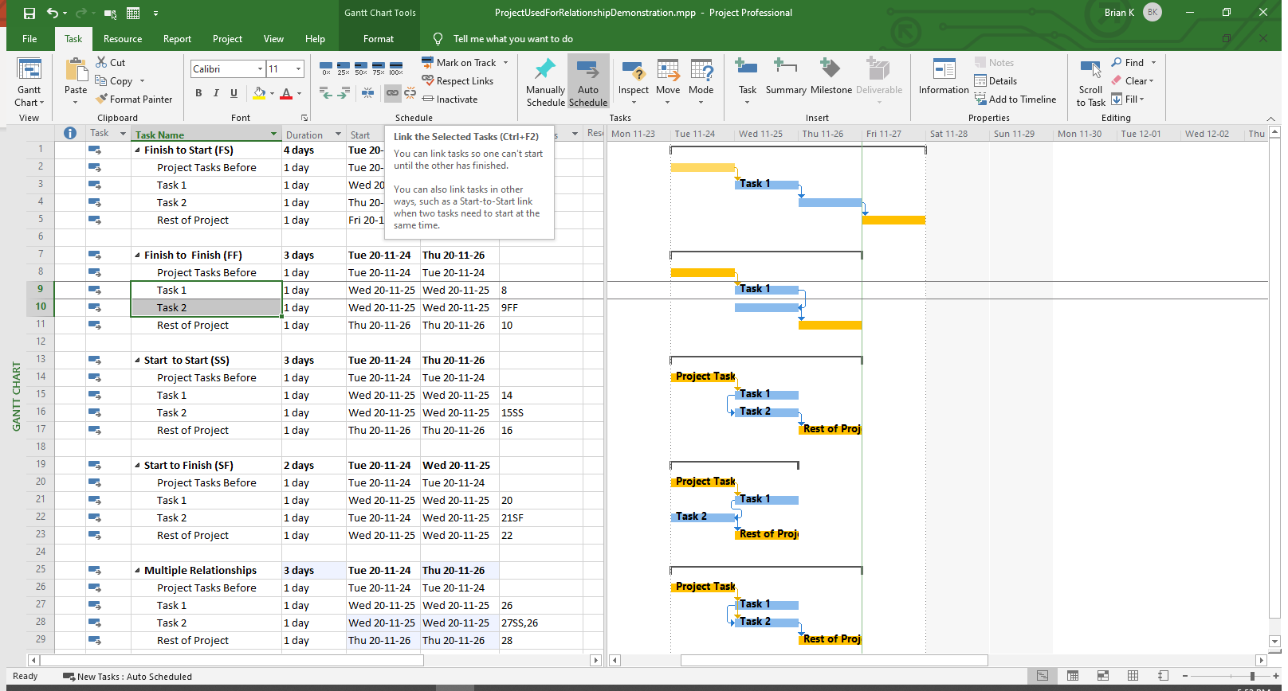
Creating Relationships –Linking
Click Link Button
Select Tasks to be Linked
Select Tasks to be Linked
By default the link will be FS and will not show the FS in the Predecessors column

Slide 50
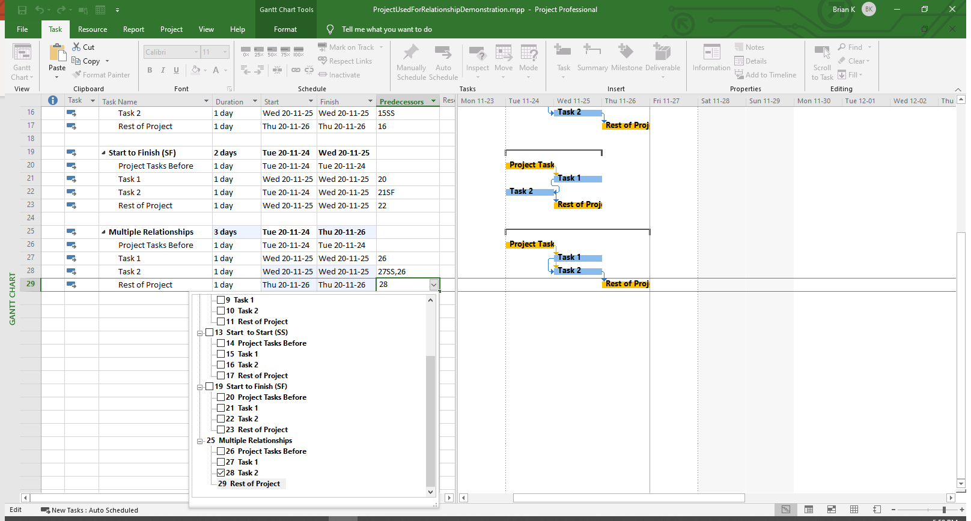
Creating Relationships –Manual Typing
Enter Predecessor and Relationship
Select Predecessor

Slide 51
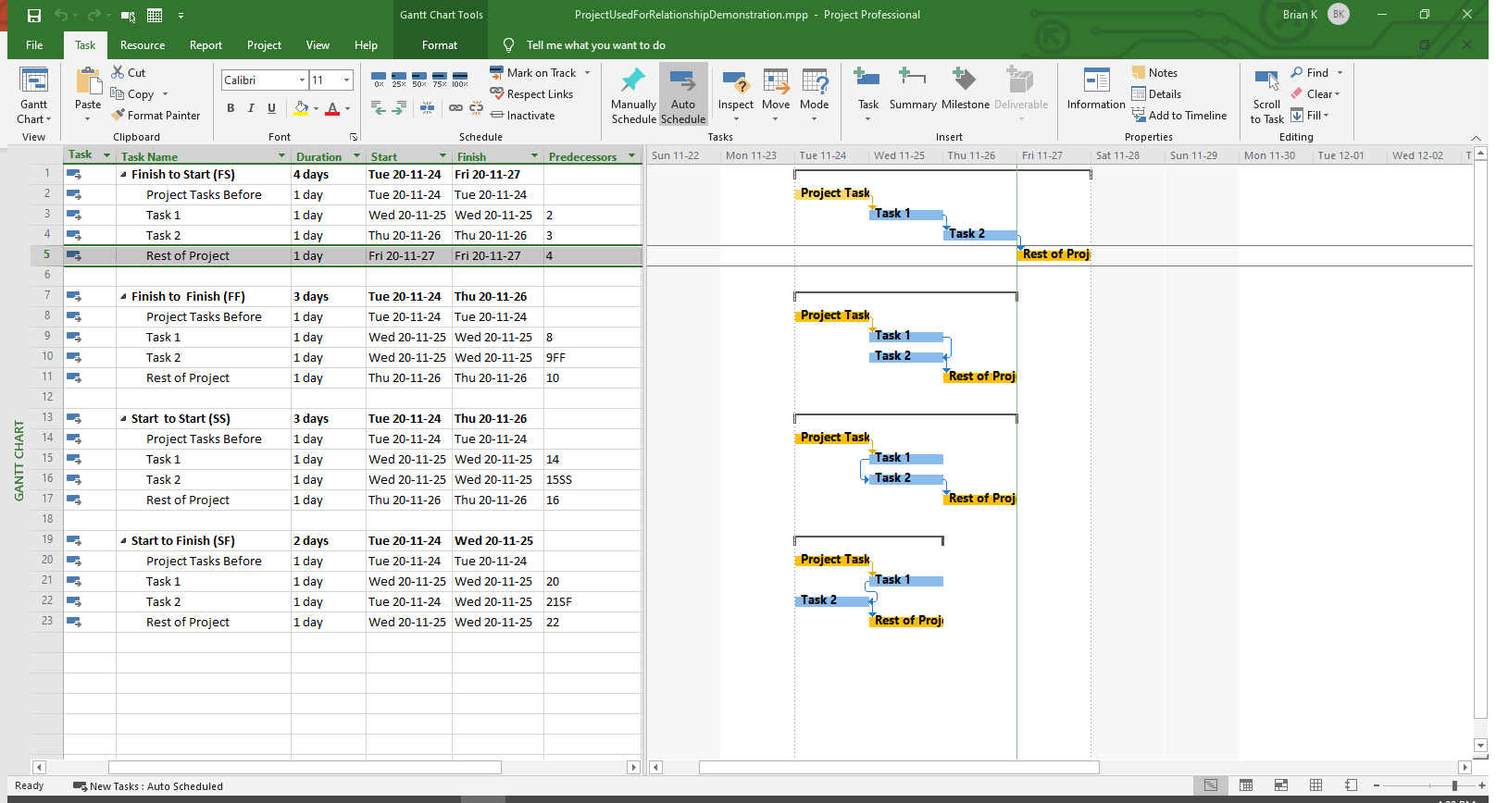
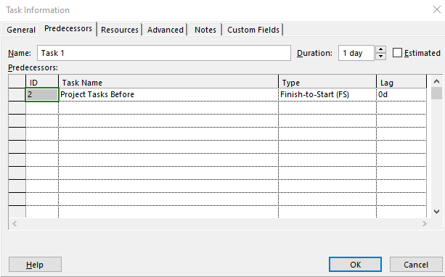
Creating Relationships –Using Task Info Dialog
Launch Task Info. Dialog
Select Task to Link to
Select Relationship Type

Slide 52
Relationship Creation Example
Create a relationship with the link button
Create a relationship with the Predecessors field
Create a relationship in the Task Information Dialog – Predecessors tab
Review examples from the Sample Relationship Schedule

